Slide 1
Project Title:
AI-Powered Social Media Content Scheduler & Generator
Name: Shaswathe Alias Bhuvaneshe
Date: 08-06-2026

Slide 2
Business Context
Project Context
Social media is important for businesses, but creating content and posting it regularly takes a lot of time. This project automates the entire process using AI and workflow automation.
Project Objective
To build an AI-powered system that automatically generates content, fetches relevant images, publishes posts to Instagram and LinkedIn, and tracks the posting status.
Expected Outcomes
Automated content generation using Google Gemini.
Automatic image retrieval from Unsplash.
Publishing content to Instagram and LinkedIn.
Approval-based posting workflow.
Status tracking and error handling.
Reduced manual effort and improved posting consistency.
Problem Statement
Creating content, finding images, getting approvals, and posting on multiple social media platforms is a repetitive and time-consuming task. Manual posting can also lead to delays and inconsistencies.

Slide 3
Problem Statement
Business Problem
Many solopreneurs and small businesses struggle to maintain a consistent social media presence.
Challenges
Manual content creation takes 1–2 hours per post
Inconsistent posting schedules
Difficulty managing multiple social platforms
Manual approval and publishing process
High risk of missed posting opportunities
Impact
Reduced audience engagement
Lower brand visibility
Time-consuming marketing operations

Slide 4
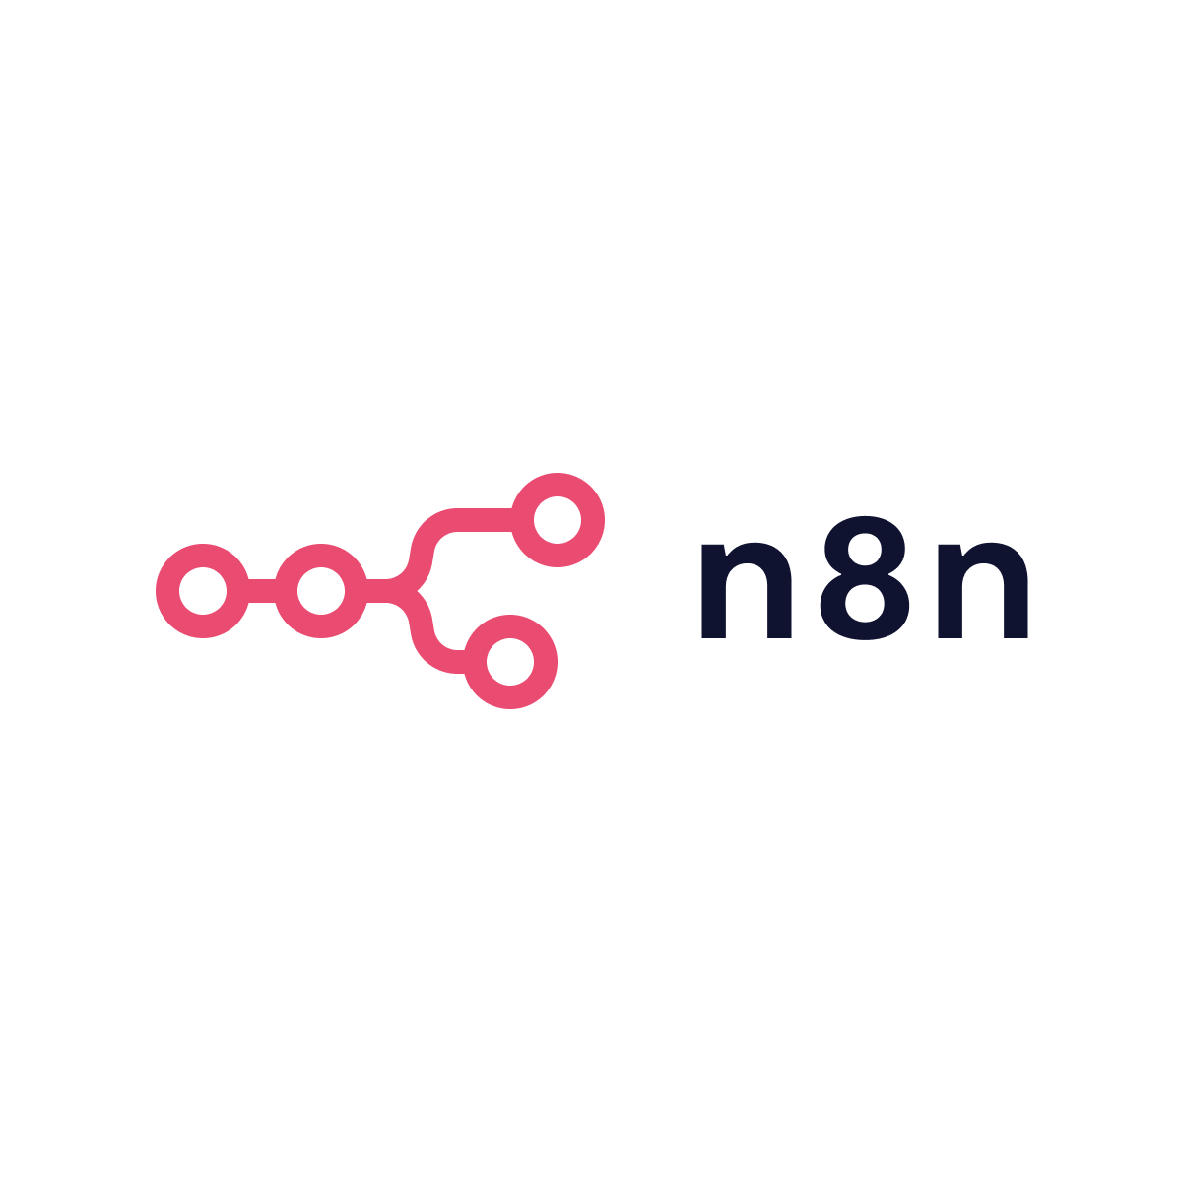
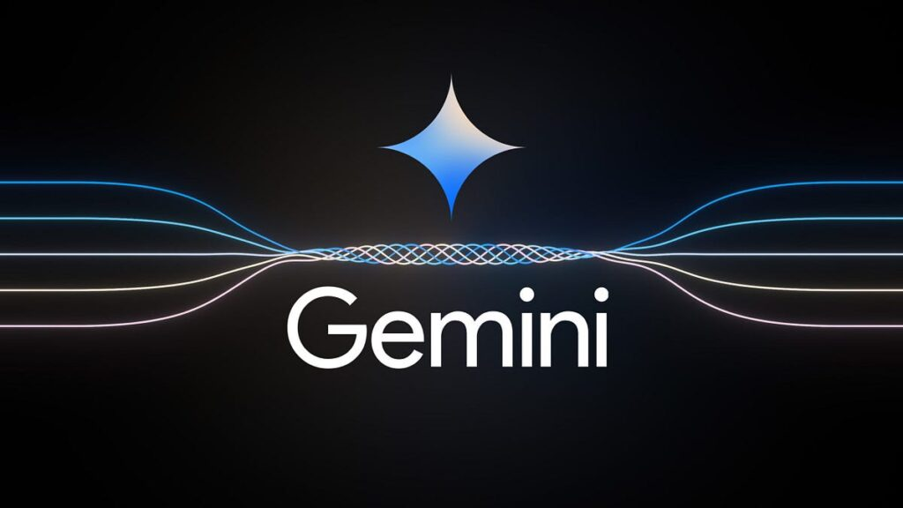
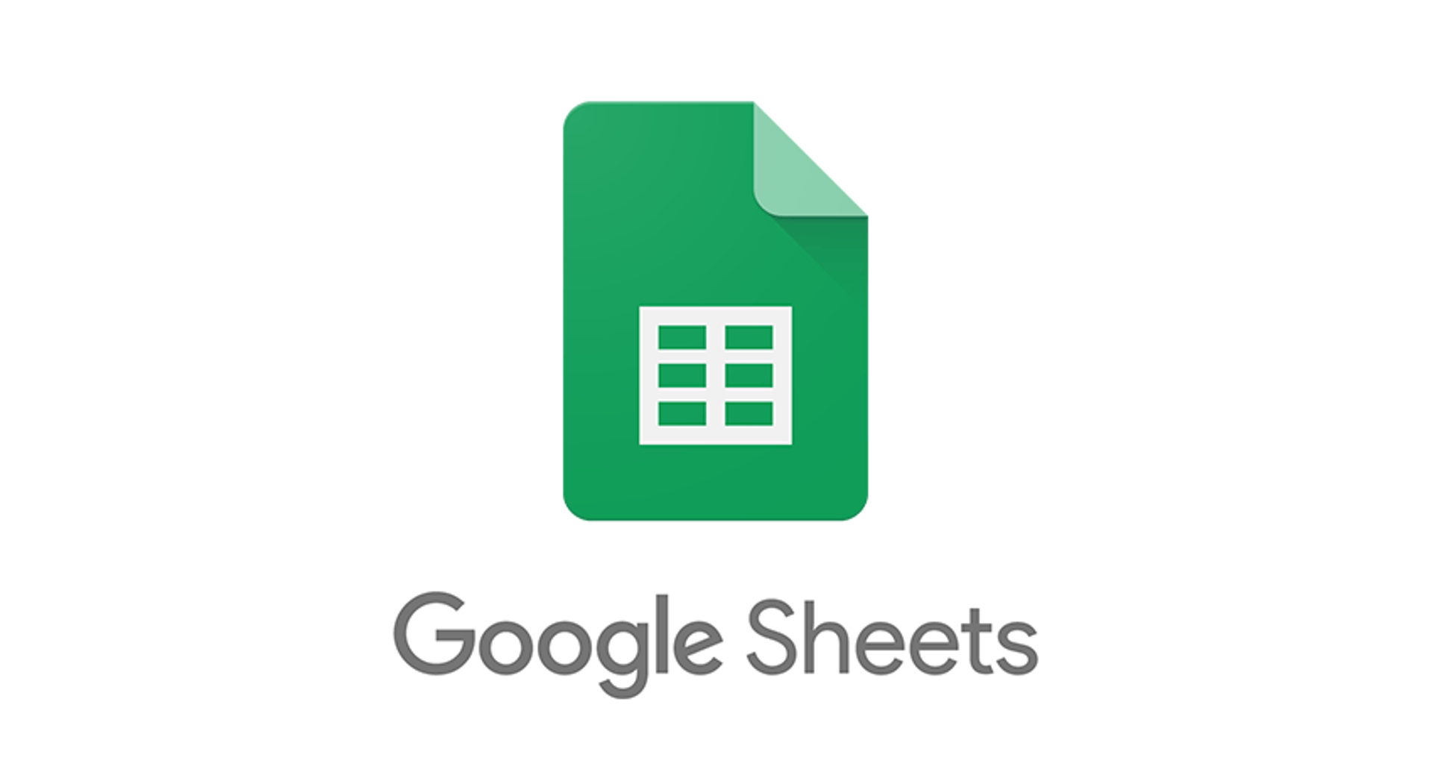

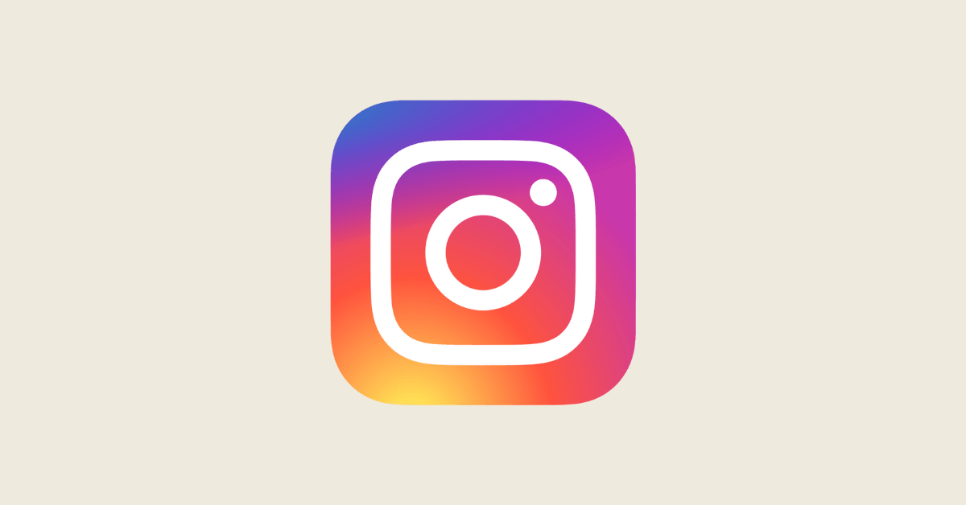

Technology Stack
Technologies:
N8n,
Google Gemini API,
Google Sheets,
Unsplash API,
Instagram Graph API,
LinkedIn API
Objective:
Automate social media content creation, approval, and publishing across multiple platforms.

Slide 5
System Architecture
n8n Workflow Architecture:
APIs Used:
Schedule Trigger
↓
Google Sheets
↓
Filter Approved Content
↓
Switch Platform
├── LinkedIn Branch
└─ Instagram Branch
↓
Wait
↓
Create Media
↓
Wait
↓
Publish Media
↓
Update Google Sheet
API | Purpose
Google Gemini | Content Generation
Unsplash | Image Retrieval
LinkedIn API | LinkedIn Publishing
Instagram Graph API | Instagram Publishing
Google Sheets API | Content Calendar

Slide 6
Feature Implemented
Key Features:
Content Generation
AI-generated marketing content using Google Gemini
Image Selection
Automatic image retrieval from Unsplash
Approval Workflow
Content approval before publishing
Multi-Platform Posting
LinkedIn
Instagram
Error Handling
Failed posts logged automatically
Duplicate Protection
Prevents reposting already published content

Slide 7
Results and Outputs
Successful Automation
Automatic:
Activity | Manual Process | Automated Process
Content Creation | 30 Mins | < 1 Min
Image Search | 15 Mins | Automatic
Publishing | 10 Mins | Automatic
Total Time | ~55 Mins | < 2 Mins
100% posting consistency
Automated content pipeline
Reduced manual effort by over 90%
Multi-platform content publishing

Slide 8
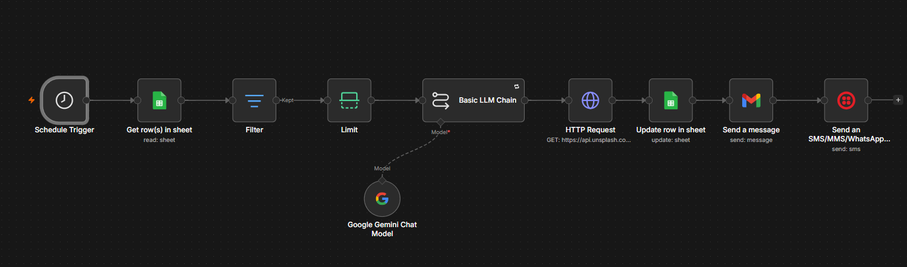
Project Workflow

Slide 9
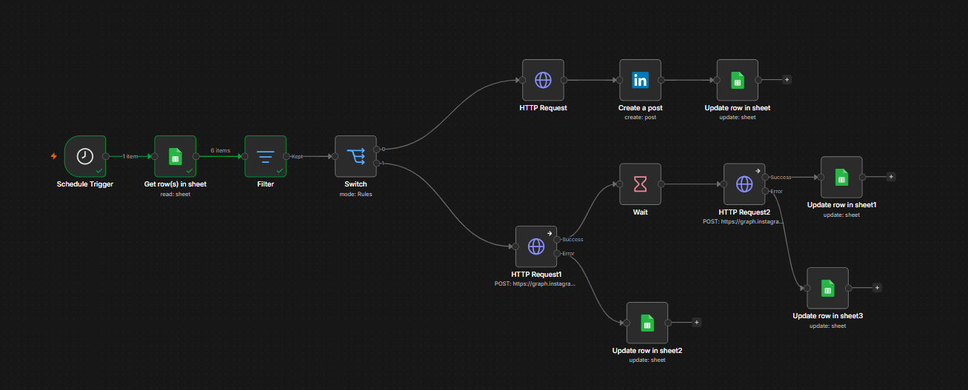
Workflow Explanation

Slide 10
Workflow Explanation
Step 1: Schedule Trigger
The workflow starts automatically at a scheduled time every day. This ensures content is generated consistently without manual intervention.
Step 2: Read Content Topics from Google Sheets
The system reads content topics and related information from Google Sheets, which acts as the content calendar and management system.
Step 3: Filter and Select Content
The workflow filters approved topics and selects the next content item that is ready for generation.
Step 4: Generate Content using Google Gemini
Google Gemini generates a complete social media post based on the selected topic, creating engaging and relevant marketing content automatically.

Slide 11
Workflow Explanation
Step 5: Fetch Relevant Image
The Unsplash API searches for and retrieves a relevant image based on the generated content topic to improve visual engagement.
Step 6: Update Google Sheets
The generated content and image URL are automatically stored back into Google Sheets for tracking and approval purposes.
Step 7: Send Notification
Once the content is generated successfully, an email notification is sent to inform the reviewer or administrator that new content is ready.
Step 8: Send Mobile Alert
A WhatsApp or SMS notification is also sent to provide instant updates and ensure timely review of the generated content.

Slide 12
Challenges & Solutions
Challenges | Solutions
Instagram Media ID Unavailable | Added Wait Node Before Publishing
Duplicate Content Posting | Implemented Posting_Status Validation
Multi-Platform Publishing | Used Switch Node For Routing
API Failures | Added Error Handling Workflow

Slide 13
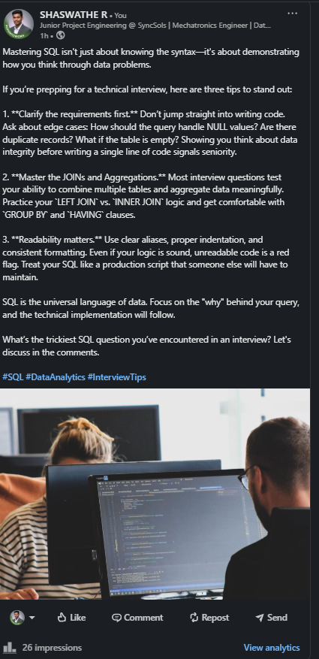
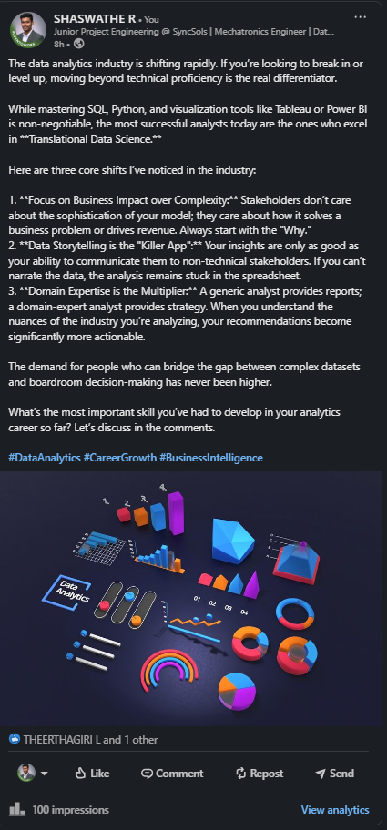
Demo Output

Slide 14
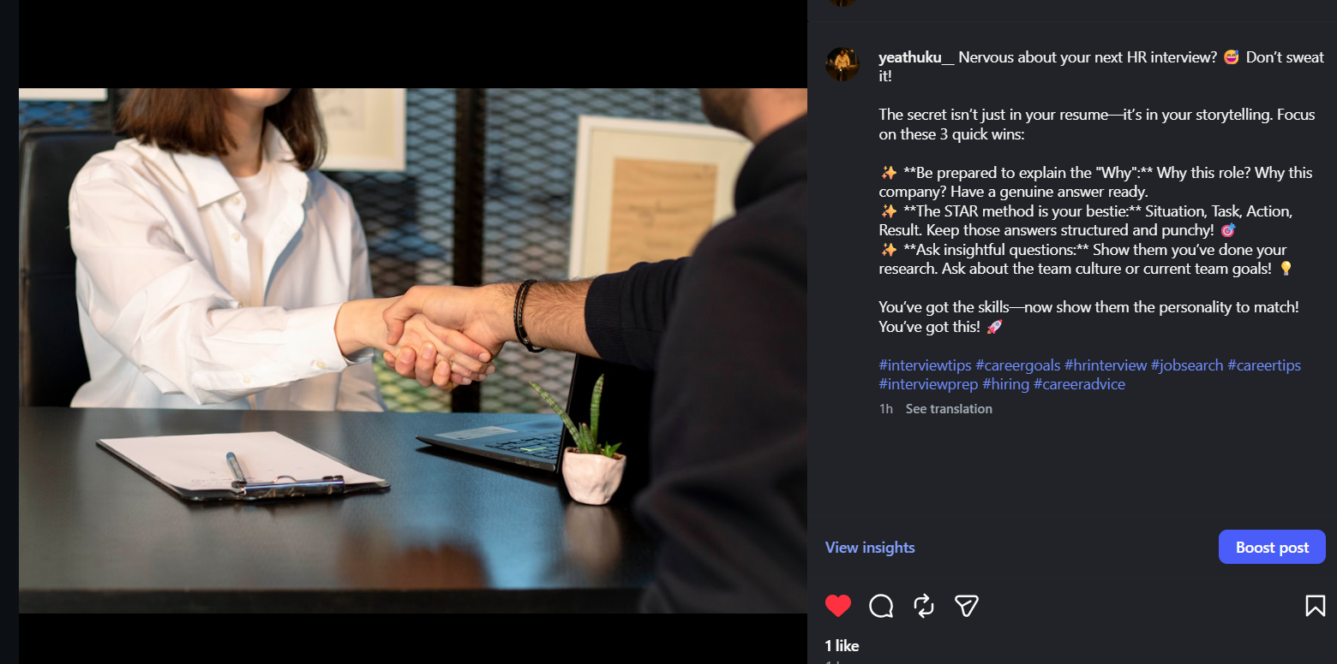
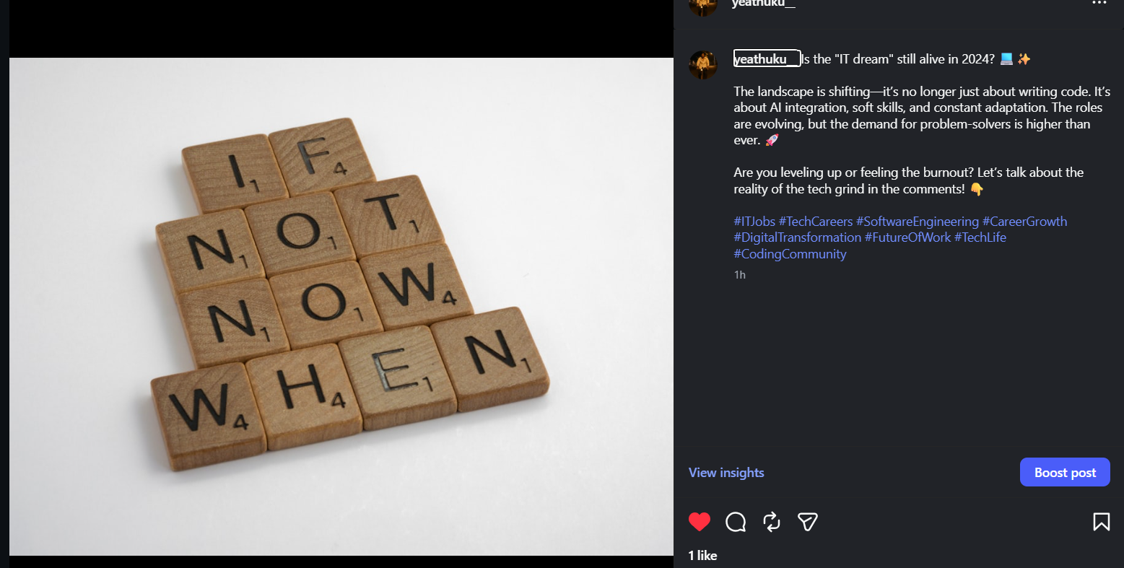
Demo Output

Slide 15
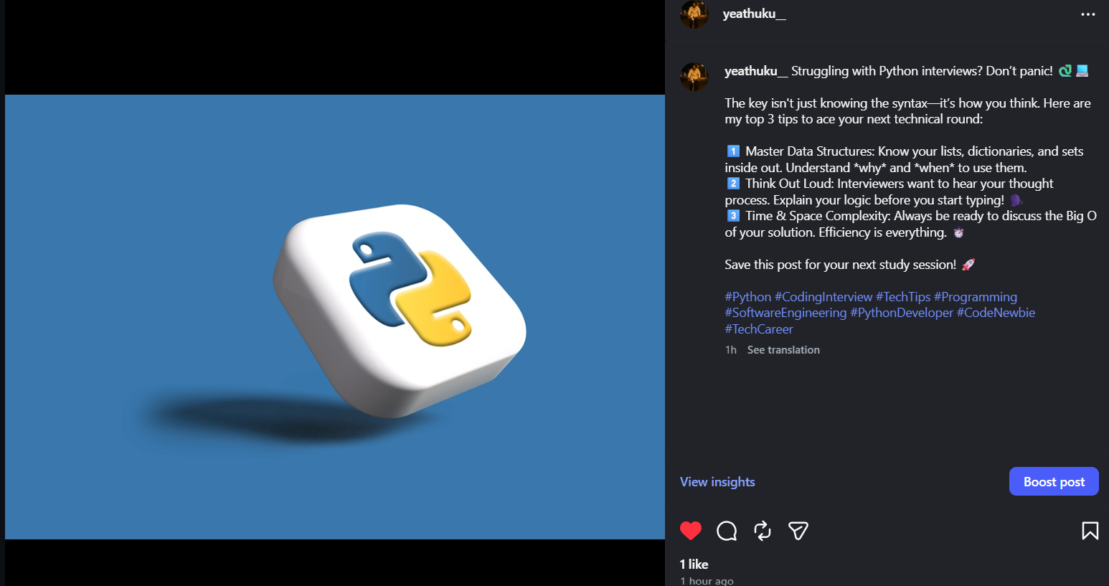
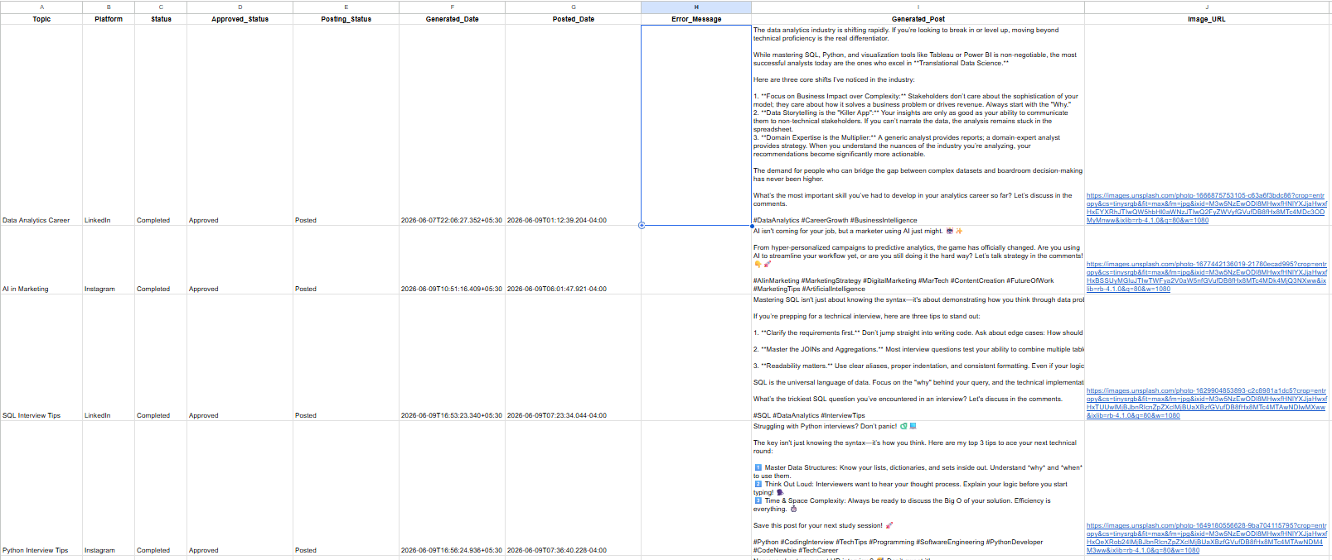
Demo Output
Successfully generated AI content, retrieved relevant images, and published posts to LinkedIn and Instagram through an automated workflow.

Slide 16
Conclusion & Skill Learned
Conclusion
Developed an AI-powered social media automation platform that generates, approves, and publishes content automatically across LinkedIn and Instagram.
Skills Demonstrated
Workflow Automation (n8n)
API Integration
Google Gemini LLM
Google Sheets Automation
Social Media Automation
Error Handling
Business Process Automation
Future Enhancements
X (Twitter) Integration
Facebook Integration
Analytics Dashboard
Auto Retry for Failed Posts
AI Performance Insights

Slide 17
THANK YOU!

